Slide 1
Controlling Classes
Initialisation and Encapsulation

Slide 2
Customising Object Creation:
Defining a Constructor
  Sometimes we don’t WANT to initialise (create) our instance (object) with a set of default values
    Why build something with X, Y and Z values, then immediately overwrite them?
  To create a completely custom instance, we need to write a constructor
    Constructor: A special method within a class that specifies the way to build an instance of that class
    Objects built using a constructor will base their starting information on the values given as parameters

Slide 3
The Rules of Constructors
  Some rules:
    The constructor name must match the name of the class
    The constructor can never return a value
  Syntax:
  public ClassName(type param1, type param2…){
  // Logic
  }

Slide 4
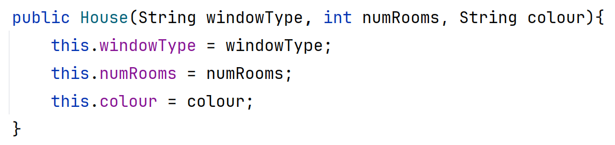
The Purpose of the Constructor
  Constructors take in values for the parts of an object
  The constructor will store the values of these parameters in their corresponding attributes
    Sets up that attribute with the supplied value
  You can include any combination of attribute information as parameters
    You can include no parameters
    You can include parameters for all attributes
    You can include parameters for some attributes and set others to default values
this lets us use the instance variable belonging to THIS object
Each parameter is stored in its corresponding attribute
Commented version on moodle:
constructors_and_encapsulation/entities/House.java

Slide 5
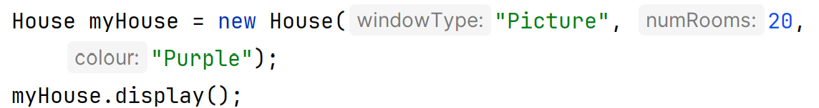
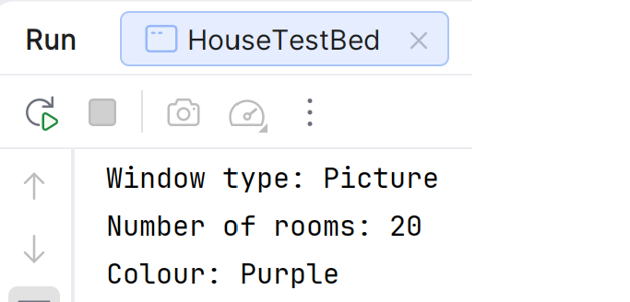
Building a Person Using Our Constructor
  To create an object/instance using a parameterised constructor, we supply values in place of each parameter:
  Syntax:
  ClassName instance_name =
  new ClassName(value1, value2…);
Output of the above
Commented version on moodle:
constructors_and_encapsulation/apps/HouseTestBed.java

Slide 6
A Note on Accessibility
  Currently, all attributes and methods in our classes are public
    Any code using this class can view and change all its information
    Any code using this class can run all its methods
  This is not always desirable:
    The data may be sensitive
    We may want to control how the information is changed
    We may want to control what can run a method

Slide 7
Encapsulation: Protecting Information & Controlling Access
  Modifier: a keyword used to encapsulate/control access to an attribute/method
    Modifiers on attributes control who can access them
    Modifiers on methods control who can call/run them
  Java’s modifiers:
    public : Accessible by every piece of code in the code base
    private: Locked – only code within the same class can use it
    protected: Locked - only code within the same class or subclasses can use it
    No modifier: Package-private – any code in the same package can access it.

Slide 8

What Data Should Be Encapsulated?
  Short answer: Everything!
  Java defaults to keeping all attributes encapsulated
    We don’t need a reason to lock attributes up
    We need a reason NOT to lock them up

Slide 9

What Methods Should Be Encapsulated?
  Short answer: It depends
  Default approach for methods is to keep them public
    We usually build methods so they can be used everywhere
  We make helper methods (methods designed to be used internally) private

Slide 10
Providing Access to Encapsulated Attributes:
Changing (Setting) Private Data
  When an attribute has been encapsulated, you should provide methods to allow calling code to safely access it
  If we want to control how/when a value is mutated/set, we include a setter method to do it
    Providing a setter method allows the class to retain control over how and when the attribute is being changed

Slide 11
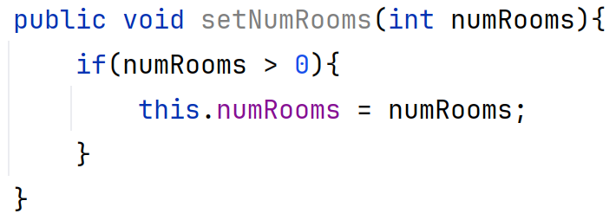
Writing Setter (Mutator) Methods
  At its core, a setter method is a very basic save:
    Store the value of the parameter supplied in its corresponding attribute
  Syntax:
    public void setAttributeName(type param){
    this.attributeName = param
    }
  You can also include conditions (if statements) to control if the information is set:
Always named after the variable it’s setting
Commented version on moodle:
constructors_and_encapsulation/entities/House.java

Slide 12
Reinstating Access to Private Attributes:
Accessing (Getting) Private Data
  When we “block” access to attributes, we may need a method to access/get the attribute’s value
    Including this method gives the class control over how & when the value is released
  We should only include it where we WANT to allow access to the value!
    Where that value shouldn’t be available elsewhere, don’t provide a way to get it.

Slide 13
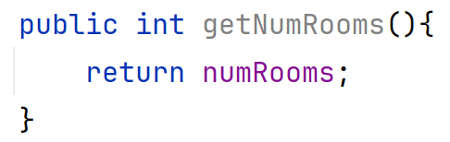
Writing Getter (Accessor) Methods
  At its core, a getter method is a very basic return:
    Return the value of the attribute being retrieved
  Syntax:
    public type getAttributeName():
    return this.attributeName
  You can also include conditions (if statements) to control how the information is released, for example:
    Require credentials to be provided and don’t return a value if the credential check fails
    Only return the information if it is within a specific range
    Only return the information if some setting in the object’s data is in use
Always named after the variable it’s getting
Commented version on moodle:
constructors_and_encapsulation/entities/House.java

